Slide 1
Preparing Data in Tableau
CSC105
Prof. Earl
Notes:
Title Slide

Slide 2
ETL Process
(E)xtract, (T)ransform, (L)oad Process
A 3 step process to get data into a place where it can be analyzed (w/ Tableau in our case).
It can be organized with four stages
1. Data Extraction
Pulling data from it’s original source (raw data).
2. Data Cleansing
3. Transformation
4. Load

Slide 3
Step 1 - Extraction
As mentioned, data comes form many different sources
Most common mediums are:
Databases
Flat files
Web Services
etc.
Global Superstore
Excel File, Access DB, Flat File (csv)

Slide 4
Steps 2&3 – Data Cleansing/Transformation
Cleaning of the data can fall under the transformation step
Potential Problems to Solve with Data Cleansing
Uniqueness
Misspelling
Duplicates
Outside Domain Range
Data Entry Errors
Naming Conflicts
Transformation
Format Standardization
Removing Duplicates

Slide 5
Step 4 – Data Loading
Loading into an application or storing in a Data Warehouse/Flat File
If we were strictly data analysis at a company, we would hopefully get the data generated from the last step to load into our program (Tableau)

Slide 6
Poorly Formatted Data
Notes:
Section Header

Slide 7
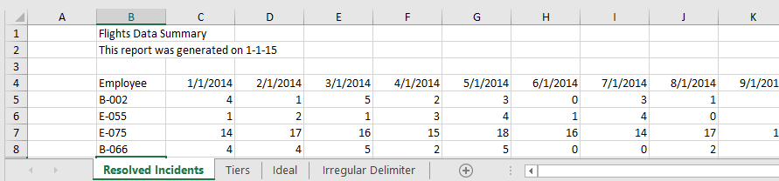
Poorly Formatted Data
Use “Data Prep – Flights” Excel file
Notes:
In our first example of connecting to data, we used an Excel file that was already formatted nicely – we just brought it straight into Tableau. In reality, data files are not always so well-formatted. Now we will practice using a file that needs some work before it is ready for analysis.
(Global Superstore, our main dataset, is too well-structured! This gives us a messier example to work with.)
Ask students what they say wrong with this sheet.

Slide 8
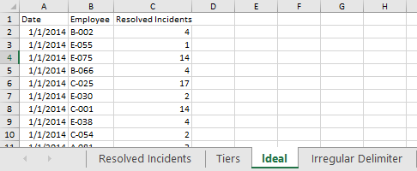
Poorly Formatted Data
Click on the “Ideal” tab
Example of proper format
Notes:
The “Ideal” tab shows how we wish the data would be formatted – like a database table.
Remind students of content covered earlier.

Slide 9
Poorly Formatted Data
Use “Data Prep – Flights” Excel file
Notes:
Many times we receive data that looks more like what we see in the “Resolved Incidents” tab. Luckily, there are several features in Tableau Desktop to help automatically reshape Text and Excel files to get them ready for analysis in Tableau.

Slide 10
Data Interpreter

Slide 11
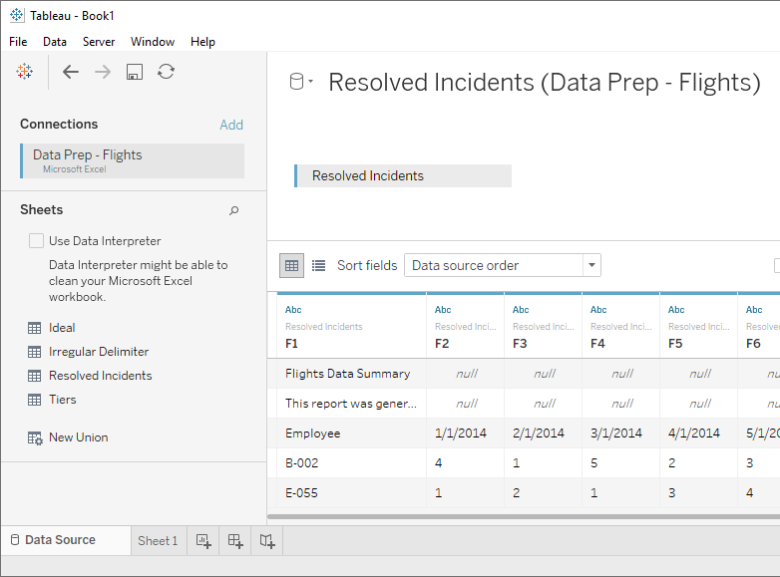
Data Interpreter
Open Tableau Desktop
Click on Excel
Navigate to saved file
Click open
Drag “Resolved Incidents” to the canvas
Notes:
Connect to this Excel file and see if we can work with that poorly formatted sheet.
Remind students of how to connect to data in Tableau
Note how the data looks in Tableau
Although Tableau can connect to this sheet, we can see here in the preview that there are some issues. There are no column names, the headers from Excel have a lot of nulls, and so on.

Slide 12
Data Interpreter
Open Tableau Desktop
Click on Excel
Navigate to saved file
Click open
Drag “Resolved Incidents” to the canvas
Notes:
Although Tableau can connect to this sheet, we can see here in the preview that there are some issues. There are no column names, the headers from Excel have a lot of nulls, and so on.
Tableau has also recognized this and suggests the Data Interpreter (Tableau’s built-in tool for preparing your data for analysis).

Slide 13
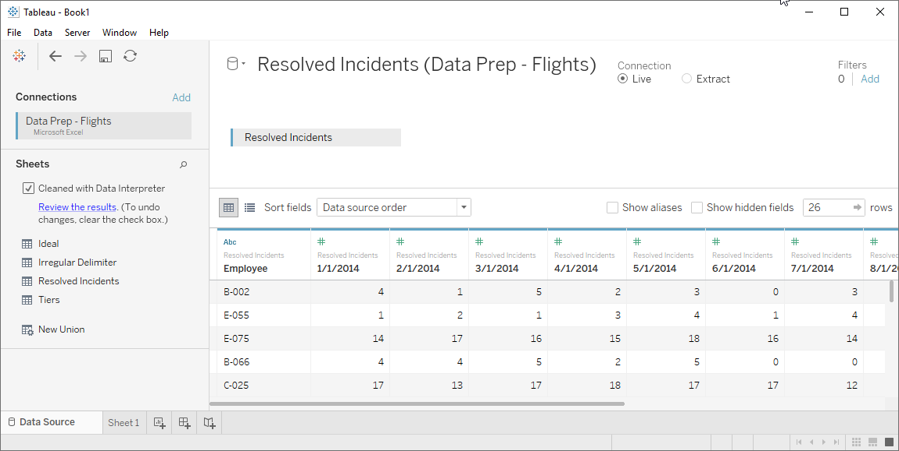
Data Interpreter
Click the Run Interpreter Box
Notes:
Now we see that those headers and nulls have been stripped out, and our columns are properly identified

Slide 14
Data Interpreter
Notes:
Click on Review the Results
If we want more specifics on what the Data Interpreter did, we can click “Review the Results” on the right. This will open an Excel file describing the changes.
If we click to the tab we used, Resolved Incidents, we see which fields are being used as headers, in red, and which are considered data, in green

Slide 15
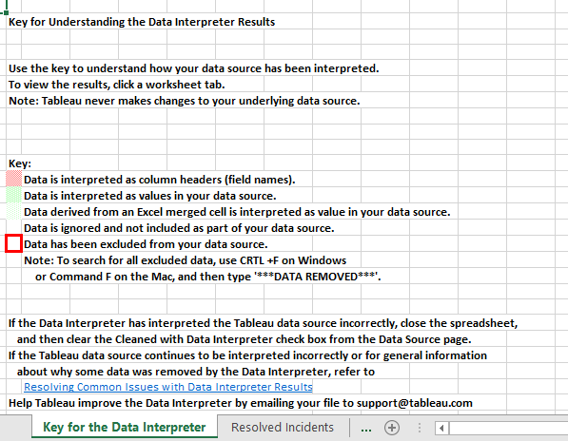
Data Interpreter Results Key
Notes:
Click on Review the Results
First sheet tab in excel shows the color key
If we click to the tab we used, Resolved Incidents, we see which fields are being used as headers, in red, and which are considered data, in green

Slide 16
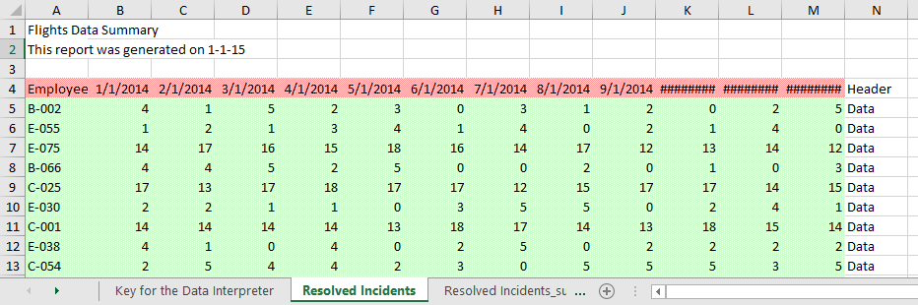
Data Interpreter Results
Notes:
Click to the Resolved Incidents tab
we see which cells are being used as headers in red
which are considered data in green
Data in white is ignored
Remind students to always review.

Slide 17
Pivot
Notes:
Section Header

Slide 18
Review Ideal Data
Notes:
Take another look at that “Ideal” tab in the original excel file.
Ask students if running interpreter in Tableau gave them the ideal format.
Note that instead of having a column for each month with data underneath, in this format, there is a “Date” column and each row contains the number of resolved incidents for each unique combination of date and employee. This data is in the preferred format for analysis: taller, with more rows, rather than wider, with more columns. Let’s see if we can do that in Tableau.

Slide 19
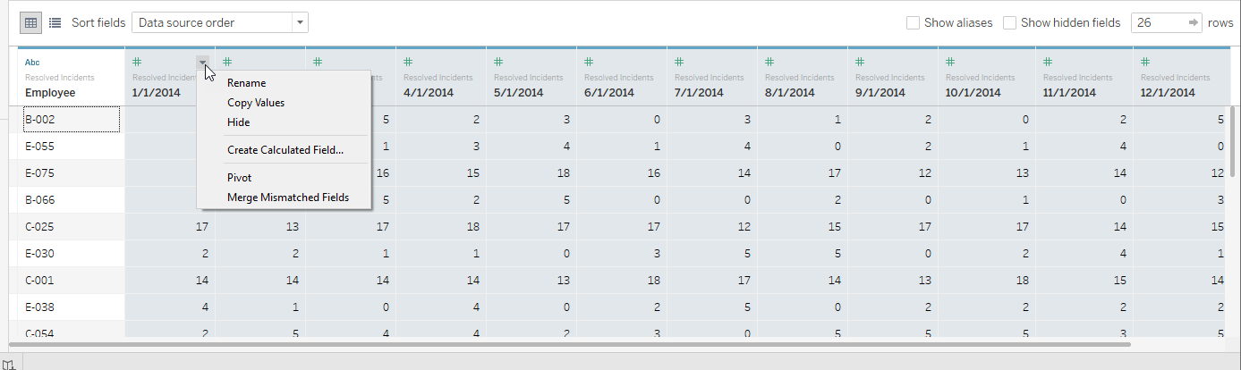
Pivot
Select all date columns
Click carat and select Pivot
Notes:
In Tableau, we want to change the format from that column-per-month layout into a single date column and a single column for Resolved Incidents.
To do this easily, we’ll simply select all the date columns. Click on the first, scroll if necessary, then shift click on the last. We’ll open the menu and select “Pivot”
This pivot feature essentially merges the information from the original columns and rows into two new columns – Pivot field names, and Pivot field values.

Slide 20
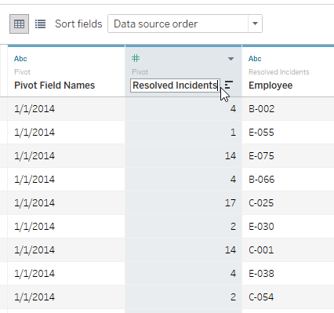
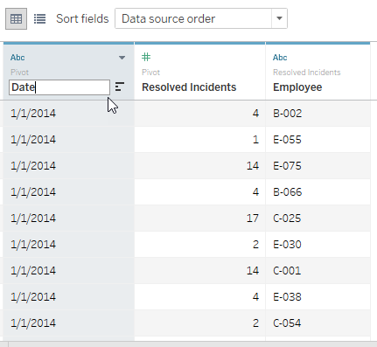
Pivot
Click on Pivot Field Values and rename to Resolved Incidents
Click on Pivot Field Names and rename to Date
Notes:
This pivot feature essentially merges the information from the original columns and rows into two new columns – Pivot field names, and Pivot field values.
We can see that “Pivot field names” is actually our Date, so we can click to open the menu and select rename.
Similarly, “Pivot field values” can be renamed “Resolved Incidents”

Slide 21
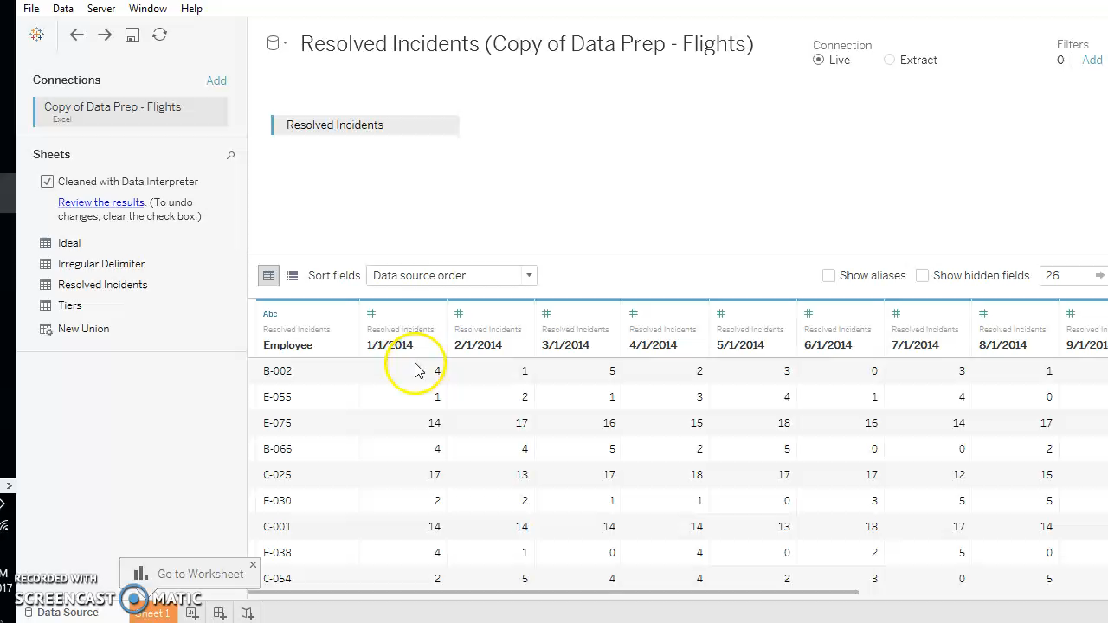
Pivot
Notes:
Instructor note: optional video of pivot steps

Slide 22
Split
Notes:
Section Header

Slide 23
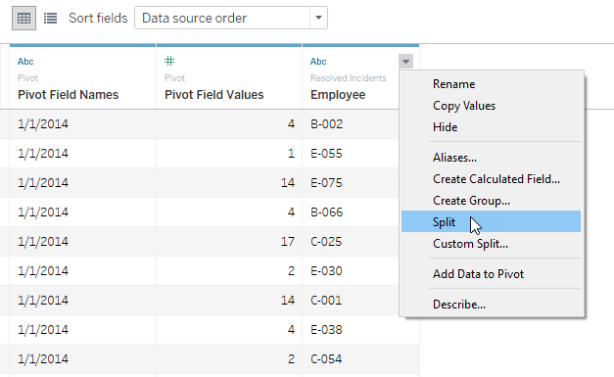
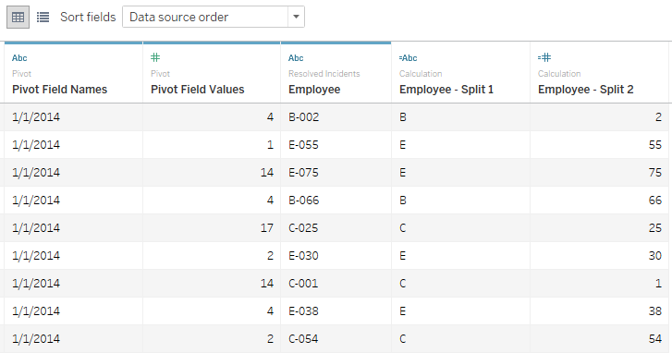
Split
Click carat and open menu of Employee field
Select Split
Notes:
Note that the “Employee” field is two pieces of information – a location code, A, B, C, D, or E, followed by an Employee ID number. We can split the column based on the hyphen delimiter:
Click to open the menu and select Split
There are now two new fields – Employee - Split 1 and Split 2

Slide 24
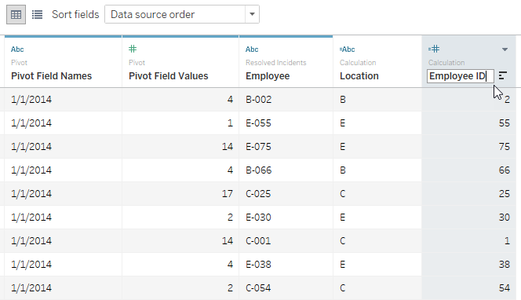
Split
Rename fields as Location and Employee ID
Notes:
Can preview for next module: Note the = sign that Tableau creates for new fields.

Slide 25
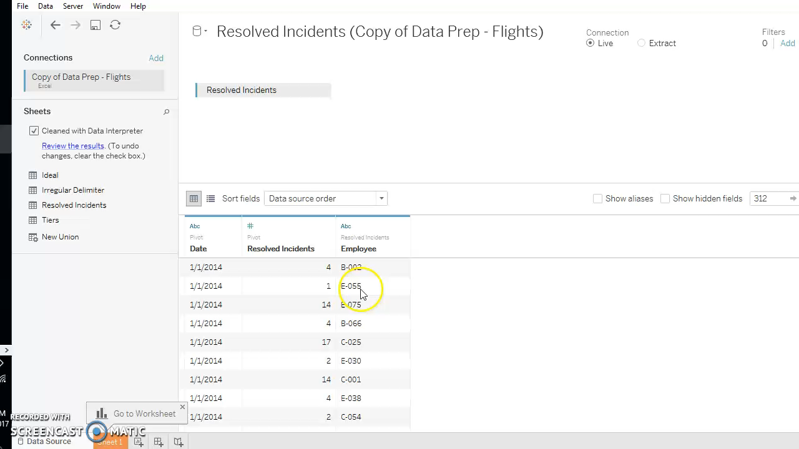
Split
Notes:
Instructor note: optional video of split steps

Slide 26
Notes:
Tableau Logo

